Slide 1
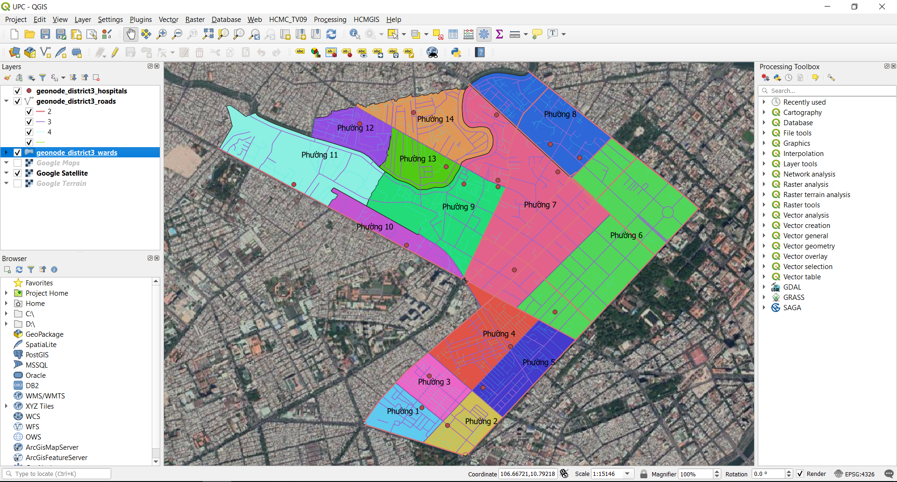
Unit 1: QGIS Overview

Slide 2
QGIS Overview
QGIS Overview, how to download and install
Useful Terms: Metadata, Encoding, CRS
Understanding QGIS Project, how to install and use Plugins
Overview of the interface: Menu, Layers list, Browser Panel, Drag and drop, Toolbars, Map Canvas, Status Bar
HCMGIS Plugin: Add Basemap, Vietnamese Font Converter, Merge/ Split files,…

Slide 3
Open Source Software
What is Open Source Software?
The term refers to how the software is licensed.
Open source software licensed so that:
Everyone can use, copy, study, and change the software in any way
The source code is available to everyone
Users are encouraged to voluntarily improve the design and functionality of the software

Slide 4
Proprietary Software
Proprietary Software?
The term also refers to how the software is licensed.
Proprietary software is software licensed so that:
The source code is not available
Use is restricted in some way:
limiting the number of computers it can be installed o
limiting the time period the software can be used
limiting the amount of data that can be processed
limiting the number of features available
limiting the fields of endeavor: educational, noncommercial…

Slide 5
Related Terms
Related terms?
Free Software (FS)?
Open Source Software (OSS)?
FOSS? (Free and Open Source Software)
FOSS4G (FOSS for Geospatial)

Slide 6


Free Software
The free software movement was conceived in 1983 by Richard Stallman to give the benefit of "software freedom" to computer users.
Stallman founded the Free Software Foundation (FSF) in 1985 to provide the organizational structure to advance his Free Software ideas.
Copyleft - says that anyone who redistributes the software, with or without changes, must pass along the freedom to further copy and change it. Copyleft guarantees that every user has freedom
VS
Copyright
Copyleft

Slide 7
Free Software
Free Software: defined by Free Software Foundation (FSF)
Four essential freedoms of Free Software:
The freedom to run the program as you wish, for any purpose (freedom 0).
The freedom to study how the program works, and change it so it does your computing as you wish (freedom 1). Access to the source code is a precondition for this.
The freedom to redistribute copies so you can help others (freedom 2).
The freedom to improve the program, and release your improvements to the public, so that the whole community benefits. .

Slide 8
Freedom of Software
Use
Modify
Redistribute
Copy

Slide 9


Free Software
Free as Freedom/ Liberty
Not as Free Beer, Free of Charge

Slide 10

Open Source Software
Open source Software:
Defined by Eric Raymond in 1998 who thought the Term “Free” would be misunderstood.
The source code and certain other rights normally reserved for copyright holders are provided under a software license that meets the Open Source Definition or that is in the public domain.
This license permits users to use, change, and improve the software, and to redistribute it in modified or unmodified forms.

Slide 11
Open Source Software
Open source Software definition on Open Source Initiative (OSI): https://opensource.org/osd
1. Free Redistribution
2. Source Code
3. Derived Works
4. Integrity of The Author's Source Code
5. No Discrimination Against Persons or Groups
6. No Discrimination Against Fields of Endeavor
7. Distribution of License
8. License Must Not Be Specific to a Product
9. License Must Not Restrict Other Software
10. License Must Be Technology-Neutral

Slide 12
Free and Open Source Software
Open source software vs. Free Software
Open Source Software and Free Software are different terms for software which comes with certain rights, or freedoms, for the user. They describe two approaches and philosophies towards free software.
They are often described as:
Open Source: a practical development methodology
Free Software: a social movement
Most Open Source software is “free” and most Free Software is “open source”

Slide 13
Free and Open Source Software
FOSS (Free and Open source Software) or FLOSS (Free/Libre and Open Source Software):
Many now just use the term: FOSS = Free and Open Source Software
The term Open Source is much more prevalent in popular culture than FOSS, but software users are beginning to use the FOSS term more frequently.
To most of us, the availability of source code isn’t the most important factor.
However, the Freedom to use the software is often very attractive.
The lack of licensing fees may also be important.

Slide 14
Free and Open Source Software
Open source licenses:
Comply with the Open Source Definition and approved by the OSI
In brief, they allow software to be freely used, modified, and shared.
Some popular OSI-approved licenses:
Apache License 2.0
BSD 3-Clause "New" or "Revised" license
BSD 2-Clause "Simplified" or "FreeBSD" license
GNU General Public License (GPL)
GNU Library or "Lesser" General Public License (LGPL)
MIT license
Mozilla Public License 2.0
Common Development and Distribution License
Eclipse Public License

Slide 15
Free and Open Source Software
OSGeo (Open Source Geospatial Foundation): a not-for-profit organization whose mission is to foster global adoption of open geospatial technology by being an inclusive software foundation devoted to an open philosophy and participatory community driven development.
https://www.osgeo.org/
FOSS4G (Free and Open Source Software for Geospatial): the annual recurring global event hosted by OSGeo since 2006
https://foss4g.org/
https://storymaps.hcmgis.vn/show-story?slug=5ccaba7e48201-FOSS4G-Archives

Slide 16
Free and Open Source Software
OGC (Open Geospatial Consortium): an international industry consortium of over 526 companies, government agencies and universities participating in a consensus process to develop publicly available interface standards.
http://www.opengeospatial.org
Some popular OGC standards:
Web Map Service (WMS)
Web Map Tile Service (WMTS)
Web Feature Service (WFS)
Simple Features
SensorThings
KML
CityGML
GeoPackage

Slide 17


Open Source GIS
A Geographic Information System (GIS) is a system designed to capture, store, manipulate, analyze, manage, and present all types of geographical data.
Some Open Source GIS Software/ Libraries/ Tools:

Slide 18
Open Source GIS
Open Source GIS Software vs Proprietary Software
FOSS | Proprietary
GeoSpatial Desktop
QGIS | ArcGIS
MapWindow | MapInfo
gvSIG | Manifold GIS
GRASS GIS | IDRISI
uDig | Intergraph
Web Mapping
GeoServer | ArcGIS Server
MapServer
QGIS Server
Spatial Database
GeoPackage | ESRI File Geodatabase
PostGIS | ArcSDE

Slide 19
QGIS
QGIS:
A Free and Open Source GIS Software licensed under the GNU General Public License.
An official project of the OSGeo.
A volunteer driven project.
Cross-platform/ multi-platform/ platform-independent software: runs on Linux, Unix, Mac OSX, Windows and Android.
Download and install: https://qgis.org/en/site/forusers/download.html (choose ver 3.4)
Documents: https://qgis.org/en/docs/index.html
How to contribute to QGIS:
Report Bugs
Participate in Support Channels
Translate QGIS
Develop a Plugin
Develop QGIS Core
Sponsor & Donate

Slide 20
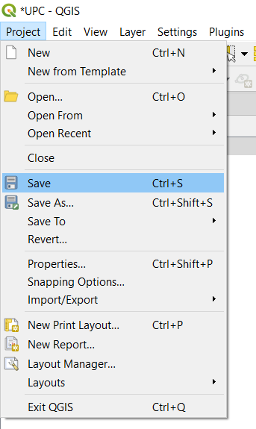
QGIS Overview
QGIS Project (.qgs or .qgz - zipped version of qgs)
QGIS Project: the current state when working in QGIS
QGIS Project:
Create a new (blank) project
Open an existing project/ recent projects
Save/ Save as
View properties

Slide 21
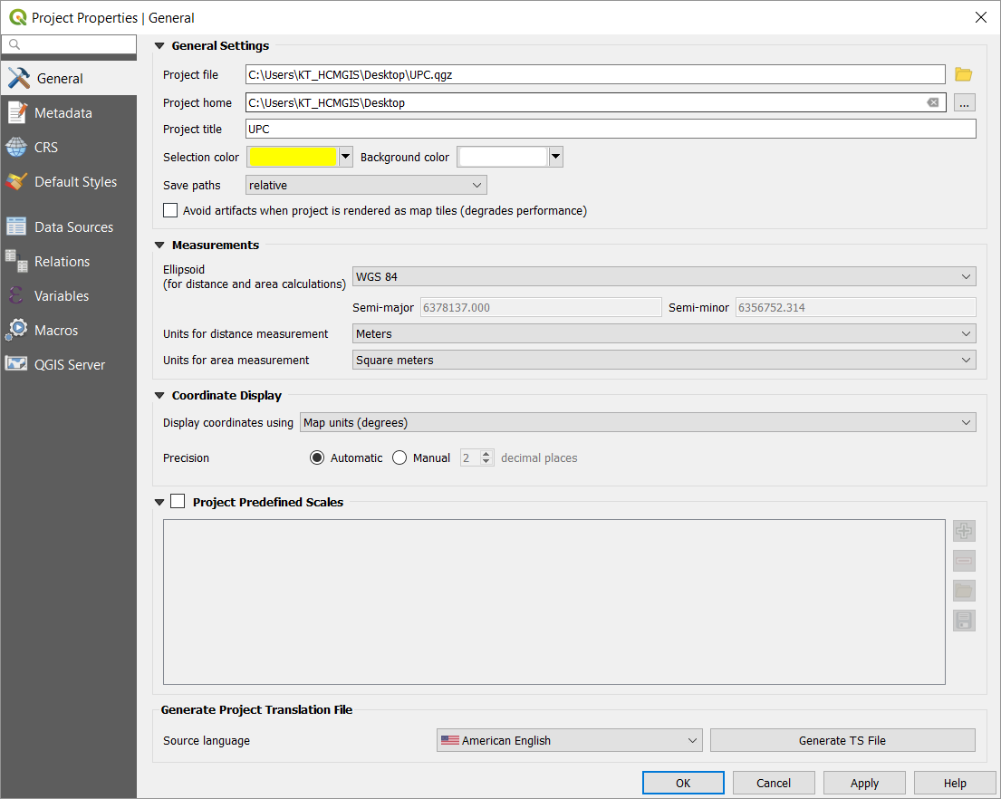
QGIS Project
Project properties:
General
Metadata
Default Style

Slide 22
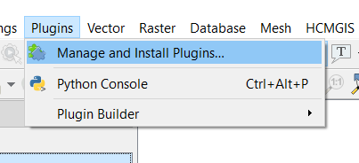
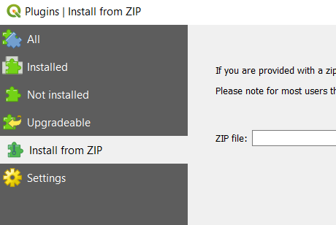
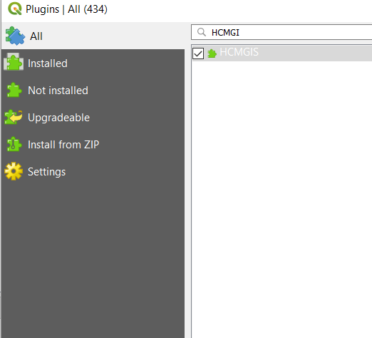
QGIS Plugins
QGIS Plugins: useful tools/ utilities added to QGIS
Install Plugin from QGIS Plugin repository (officially approved by QGIS Team)
Install Plugin from zip file

Slide 23
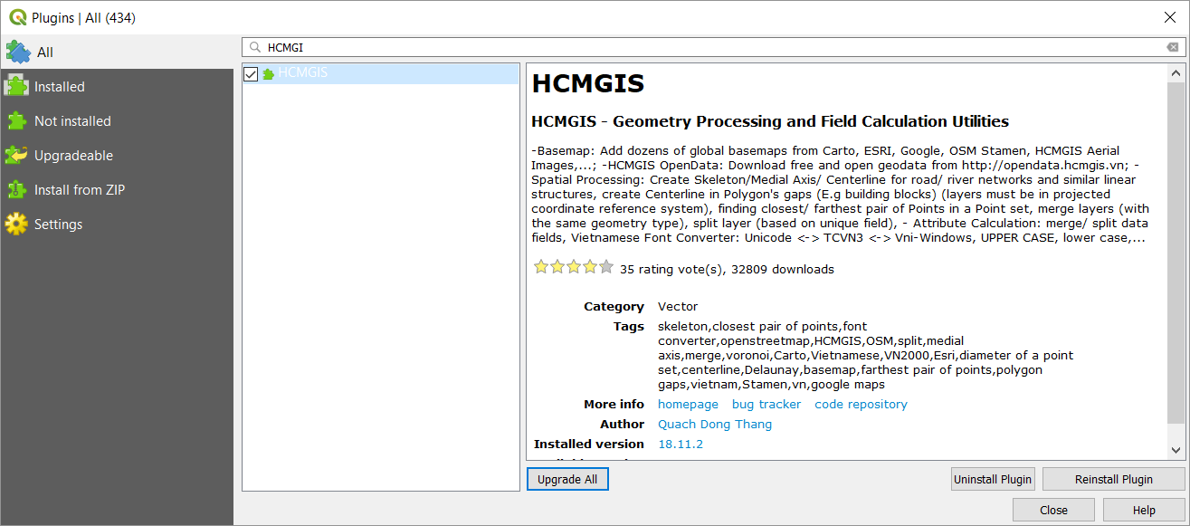
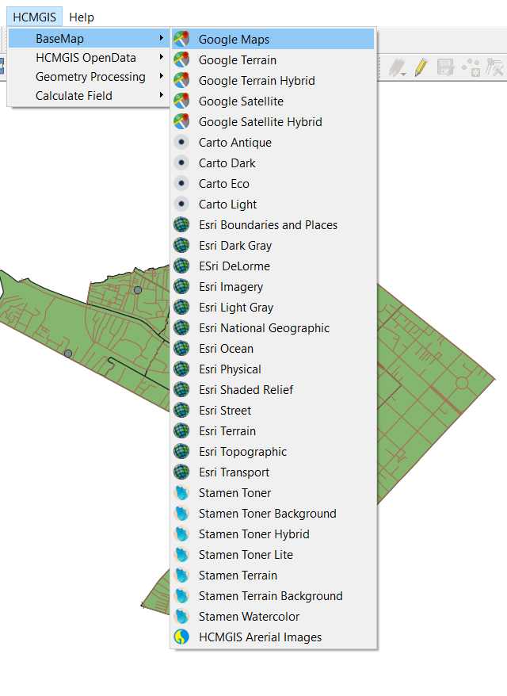
HCMGIS Plugin

Slide 24
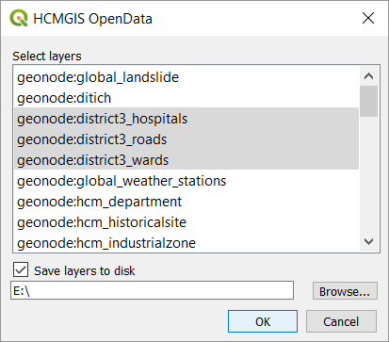
Download Sample Data
QGIS Plugins → HCMGIS OpenData → Download Free and Open Data → Choose District 3 Sample Data (Point, Line and Polygon), Check save to Disk

Slide 25
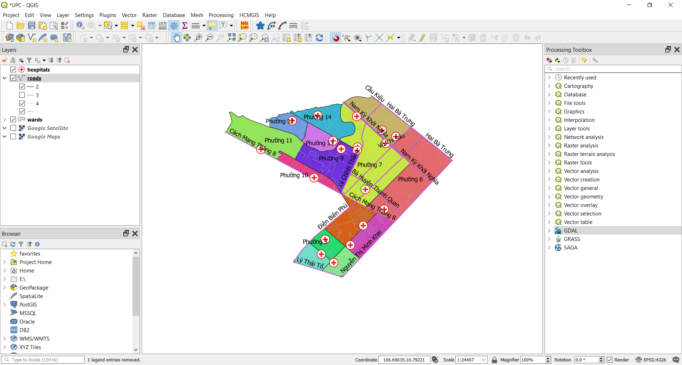
QGIS GUI

Slide 26
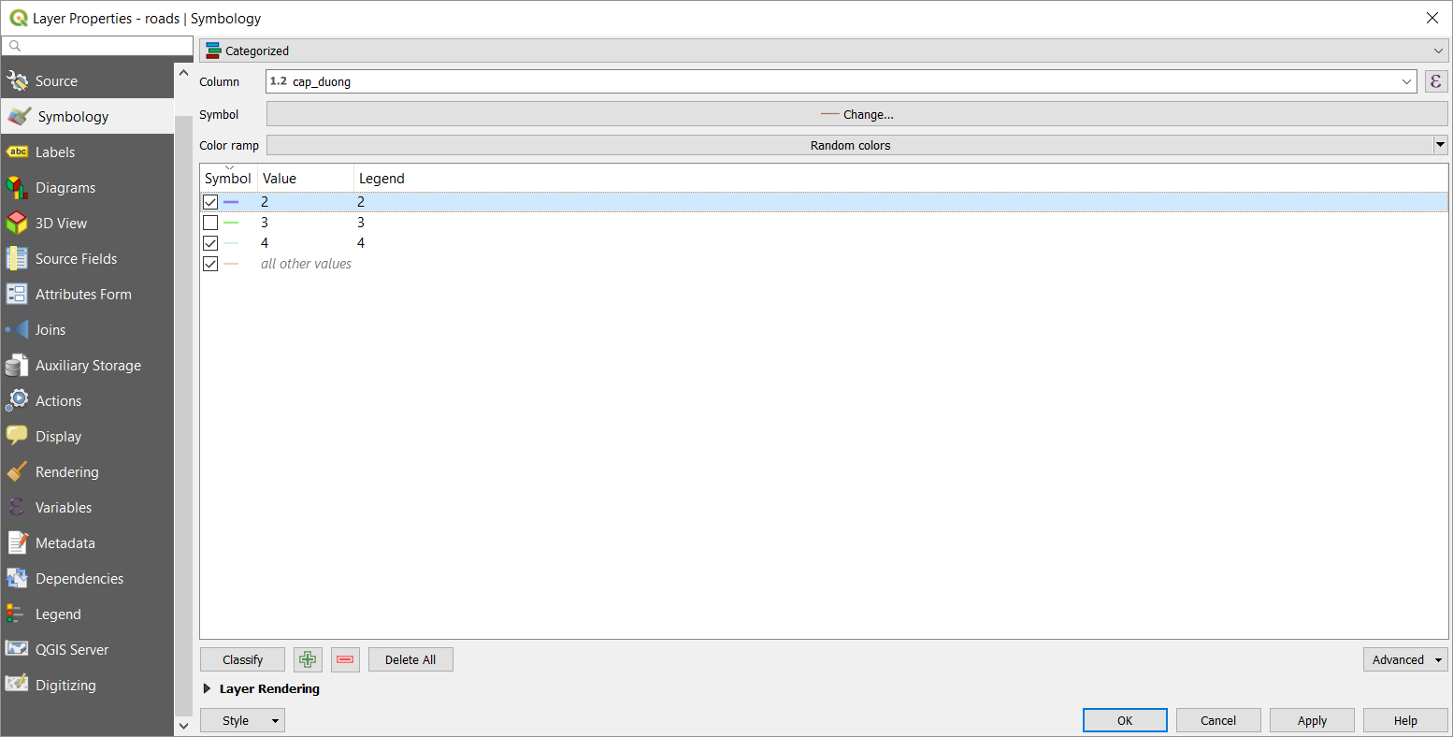
Layer Properties
Symbology:
Single Symbol
Categorized

Slide 27
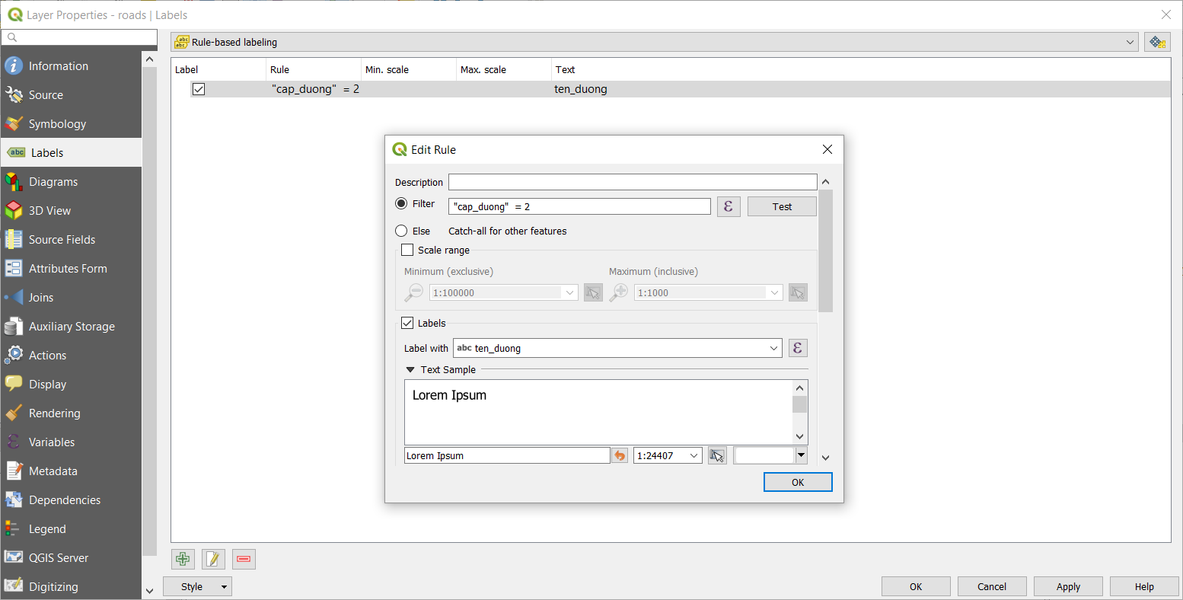
Layer Properties
Labels:
Single Labels (using Expression)
Rule-based Labeling

Slide 28
Layer Properties
Exercises:
Create a new project in QGIS
Install HCMGIS Plugin
Download Sample Data from HCMGIS Plugin
Add Basemap from HCMGIS Plugin
Reorder Layers, Drag and Drop, Group
View Attribute Table, Select feature, Identify feature
Labeling
Symbology

Slide 29
Keep Calm and enjoy Learning!
https://hcmgis.vn
HCMGIS – GIS for the City, GIS for the Community

